Slide 1


AI-Powered Career Guidance System
Presented by: Avinash Pamarthi
Roll Number: 24KN5A0509 ~ BATCH 15
Department: CSE, NRI Institute of Technology

Slide 2

01
AI-Powered Career Guidance System

Slide 3
CONTENTS
1. Title Slide
2. Introduction
3. Problem Statement
4. Objectives
5. Proposed System
6. Modules Overview
7. Technologies Used
8. Advantages
9. Limitations
10. Future Enhancements
11. Conclusion
12.Thank You

Slide 4

02
Introduction

Slide 5





Overview of the Project
Explore suitable career paths tailored to their skills and interests.
This project is an AI-powered career guidance system that assists students in multiple ways:
2
1
Analyze their resumes for improvement and provide actionable feedback.
3
5
Prepare for interviews with mock questions to build confidence.
4
Suggest personalized learning paths to bridge knowledge gaps.

Slide 6

03
Problem Statement

Slide 7



Issues Faced by Students
Manual counseling processes are time-consuming, often leading to inaccurate advice and extended waiting periods.
2
Students often struggle to find career guidance that is specifically tailored to their individual skills and interests.
1
There's a significant gap existing between educational outcomes, self-assessment of skills, and preparedness for the industry.
3

Slide 8

04
Objectives

Slide 9




Goals of the Project
Provide career suggestions based on user inputs and their backgrounds.
Analyze resumes and furnish constructive feedback for improvement.
Recommend tailored learning paths along with free resources for effective study.
Conduct mock interviews to aid users in preparation and build confidence.

Slide 10

05
Proposed System

Slide 11
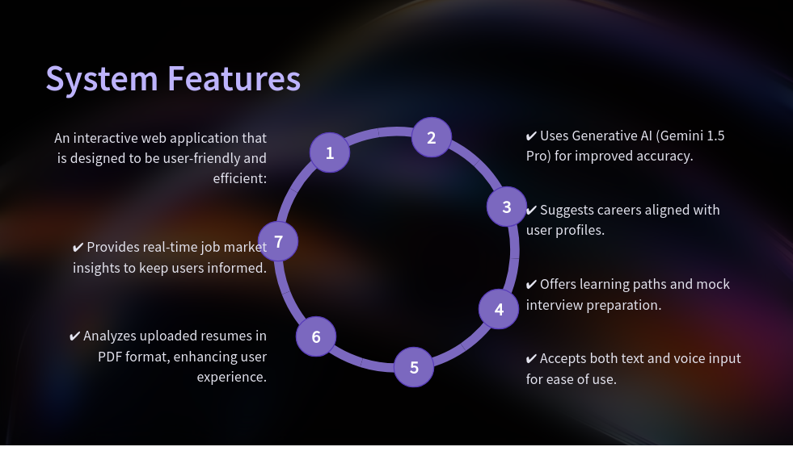
nt:

Slide 12

06
Modules Overview

Slide 13

Breakdown of the System
The proposed system will encompass several crucial modules:
Career Guidance
Resume Analyzer
Learning Path Recommendations
Mock Interview with voice & timer
Job Market Insights
Networking Suggestions for career growth and opportunities.

Slide 14

07
Technologies Used

Slide 15






Tech Stack Overview
The project integrates diverse technologies to deliver an effective solution:
1
2
Frontend: Streamlit, HTML/CSS
6
Text-to-Speech Output: pyttsx3
3
Backend: Python
5
Voice Input Library: SpeechRecognition
4
AI Component: Google Generative AI (Gemini 1.5 Pro)

Slide 16


Tech Stack Overview(2)
1
Data Visualization Tools: Pandas
PDF Reading Library: PyPDF2
2

Slide 17





Visual Representation
Resume Analyzer output
Career Guidance form
Mock Interview questions
Suggested Learning Path
Homepage
3
2
4
1
5

Slide 18
08
Advantages

Slide 19

Benefits of Using the Application
AI-based personalized guidance to enhance user satisfaction.
Reduces confusion in making career choices by providing clarity.
Enhances resumes, ensuring users are job-ready.
Easy and accessible information to free learning resources.
Provides a realistic interview practice experience to prepare users.

Slide 20
09
Limitations

Slide 21




Challenges Faced by the System
The application's effectiveness is dependent on the quality of user input; inaccurate data leads to suboptimal suggestions.
Current resume analysis features may not handle all formats effectively.
1
2
4
3
Emphasizes the need for user trust and strong data privacy assurances to ensure confidentiality.
Requires stable internet connectivity for seamless API responses.

Slide 22
10
Future Enhancements

Slide 23




Proposed Improvements
Expand the application to include multilingual support, such as Telugu, to serve a broader audience.
Incorporate features for tracking user skill progress over time to provide tailored advancements.
1
2
Develop a resume builder equipped with live feedback and tips to streamline the creation process.
Integrate options for connecting with real mentors or counselors for personal guidance.
4
3

Slide 24
11
Conclusion

Slide 25



Closing Remarks
This application exemplifies how AI can:
Effectively bridge the gap between education and employability challenges.
Guide students towards informed career choices for better outcomes.
Furnish practical tools designed to enhance career success and readiness.

Slide 26
12
Thank You

Slide 27





Engagement with the Audience
1
2
Any Questions?
Presented by: Avinash Pamarthi
Email: pamarthiavinash07@gmail.com
GitHub: Avinash_Creates
4
3

Slide 28
Thank You

